Slide 1

OS Scheduler
Notes:
1

Slide 2
AGENDA
  Introduction
  Algorithms description
  Assumptions
  Input & Output samples
  Figures
  Findings & Key observations

Slide 3
Introduction
The OS Scheduler Simulator is a desktop application developed using Python and PyQt5. It simulates multiple CPU scheduling algorithms including:
FCFS (First Come First Serve)
Non-Preemptive Priority
Round Robin
SRTF (Shortest Remaining Time First)

Slide 4
Introduction
Key features:
Process generation using statistical distributions
Gantt chart visualization of scheduling
Performance comparison of algorithms via bar graphs
Exporting results to CSV and PDF formats

Slide 5
Algorithms description
FCFS: Processes are scheduled in the order they arrive in the ready queue. The earliest arriving process is executed first.
Non-Preemptive Priority: Processes are scheduled in the order they arrive in the ready queue. The earliest arriving process is executed first.
Round Robin: Each process gets a fixed time slot (quantum) in a cyclic order. If a process doesn’t finish in its time slice, it’s placed at the end of the queue.
SRTF: The process with the shortest remaining execution time is selected. If a new process arrives with a shorter remaining time, it preempts the current one.

Slide 6
ASSUMPTIONS
We assumed quantum time is fixed at 2(default) for Round Robin and can be changed by user
We assumed that the Priority with the lowest number is the highest Priority

Slide 7
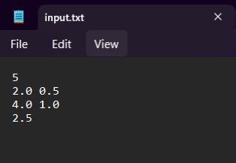
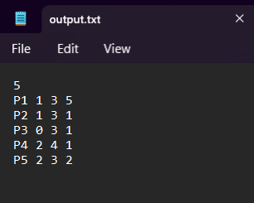
Input & output samples
INPUT SAMPLE:
OUTPUT SAMPLE:

Slide 8
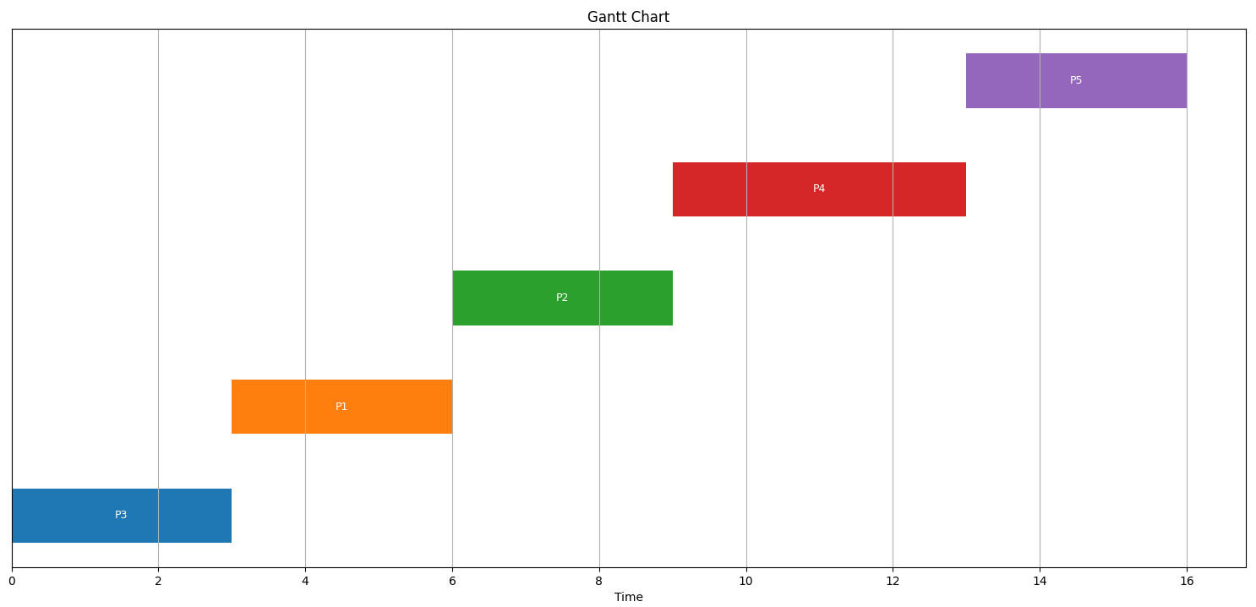
FIGUReS
FCFS GANTT CHART:
Average Waiting Time : 5
Average TurnAround Time: 8.2

Slide 9
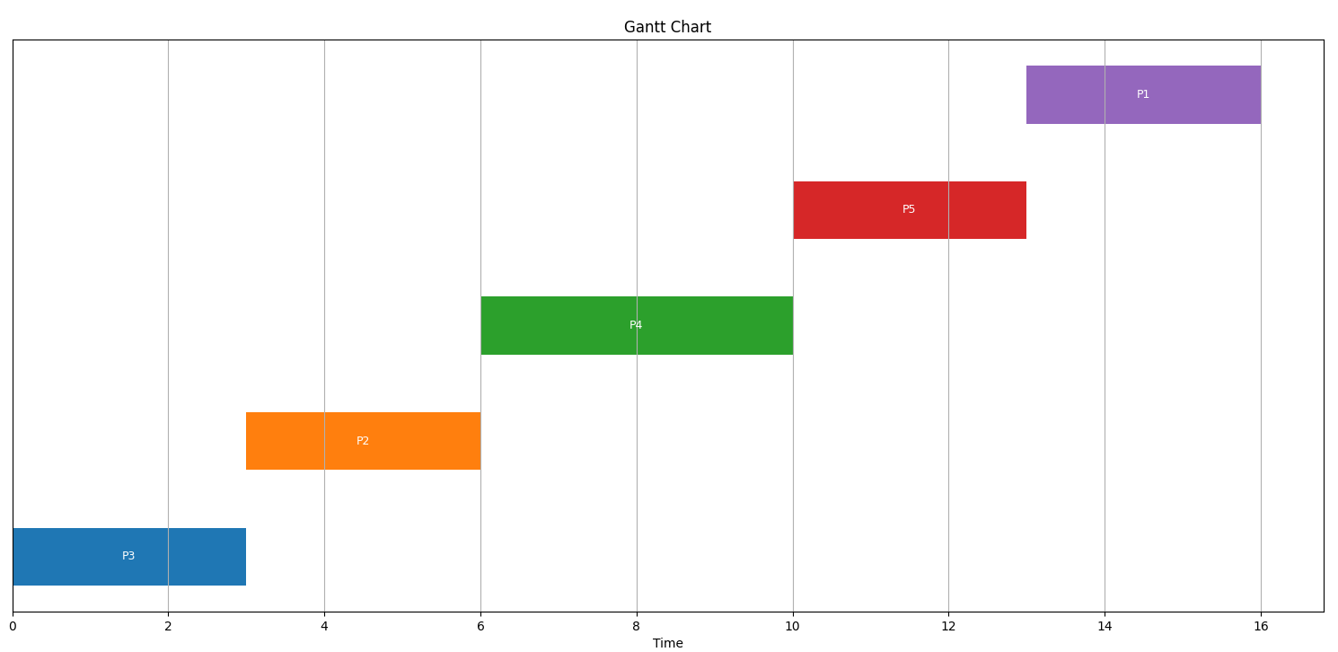
FIGUReS
Non-Preemptive Priority GANTT CHART:
Average Waiting Time : 5.2
Average TurnAround Time: 8.4

Slide 10
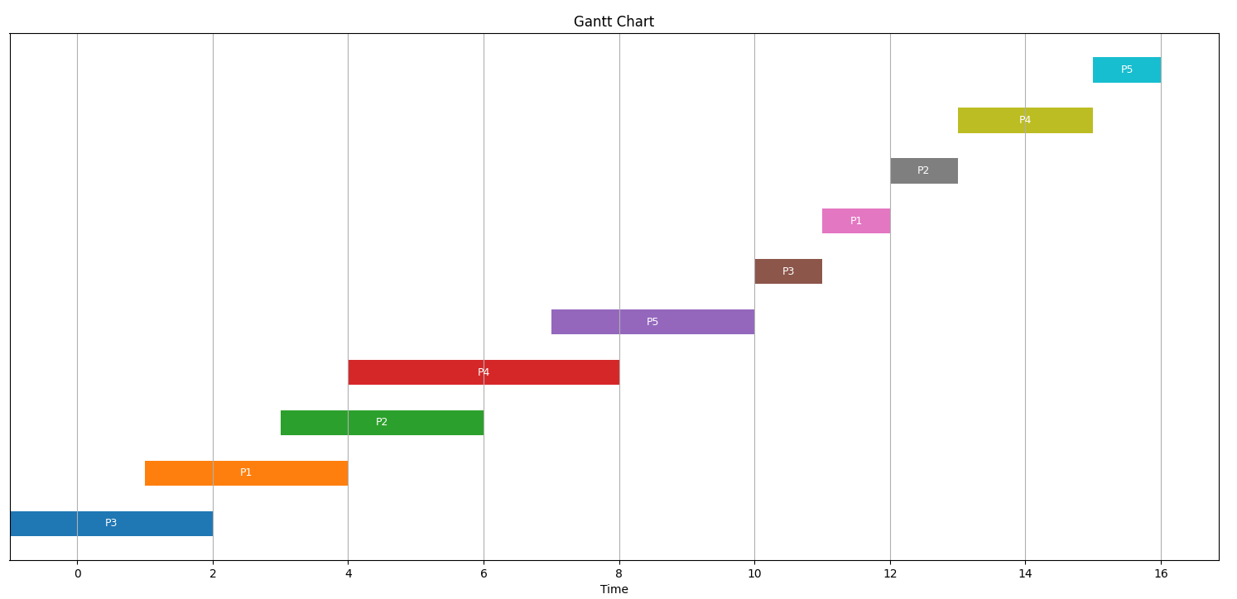
FIGUReS
Round Robin GANTT CHART:
Average Waiting Time : 6.3
Average TurnAround Time: 8.5

Slide 11
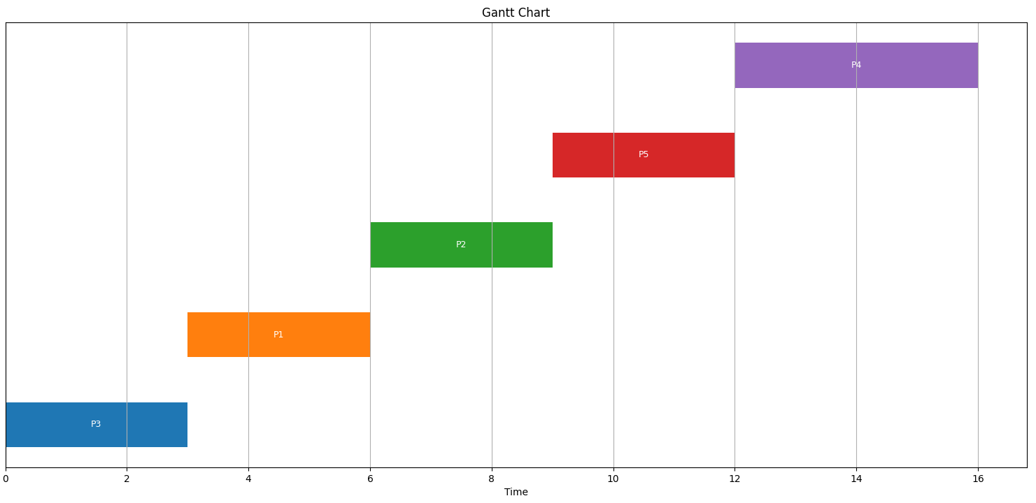
FIGUReS
SRTF GANTT CHART:
Average Waiting Time : 4.8
Average TurnAround Time: 8

Slide 12
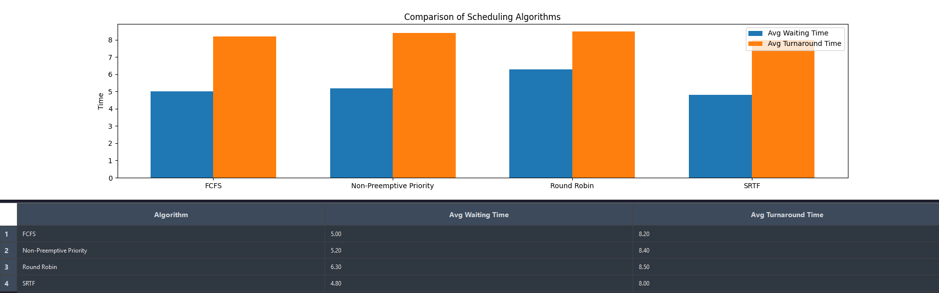
FIGUReS
Compare all Algorithms GANTT CHART:

Slide 13
Findings & Key observations
ALGORITHM | Average Waiting TIme | Average TurnAround TIme | Key Observation
FCFS | 5 | 8.2 | Simple, fair order, affected by convoy effect, not optimal for mixed-length processes
Non-Preemptive | 5.2 | 8.4 | Slightly worse than FCFS, priority impact is minimal without preemption
Round Robin | 6.3 | 8.5 | Highest waiting and turnaround times, performance depends on time quantum size
SRTF | 4.8 | 8 | Best performance, lowest Waiting Time, minimizes both metrics, effective when burst times are known

Slide 14
Team members
Mohamed Saeid 407 C4
Youanas Ibrahim 403 C4
Farouq Abdellatif 406 C4
Ahmed Emam 409 C4
Andrew Adel 420 C4
Notes:
1

Slide 15
THANK YOU

